Slide 1
NLP Recurrent Neural Networks lecture 05.1
Branko Žitko
Source: DeepLearning.AI

Slide 2
Contents
Nosation
Recurrent Neural Network model
Backpropagation through time
Different types of RNNs
Language model and sequence generation
Sampling novel sequences
Vanishing gradients with RNNs
Gated Recurrent Unit (GRU)
LSTM (long short term memory) unit
Bidirectional RNN
Deep RNNs

Slide 3


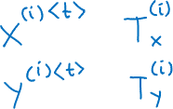
Motivating example
x: Harry Potter and Hermione Granger invented a new spell.

Slide 4
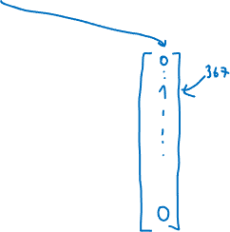
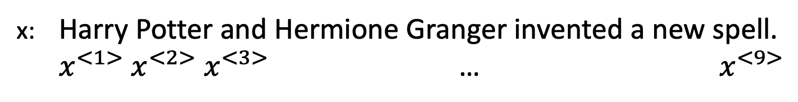

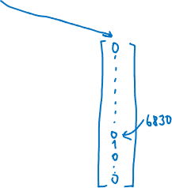


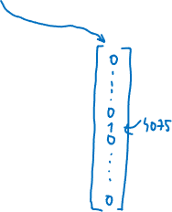
Representing words
x: Harry Potter and Hermione Granger invented a new spell.
$x^{<1>} x^{<2>}$ $x^{<3>}$ … $x^{<9>}$

Slide 5






Why not a standard network?
$$y^{<1>}$$
$$x^{<1>}$$
$$y^{<2>}$$
$$x^{<2>}$$
…
…
…
…
$$y^{<T_{y}>}$$
$$x^{<T_{x}>}$$
Problems:
Inputs, outputs can be different lengths in different examples.
Doesn’t share features learned across different positions of text.

Slide 6

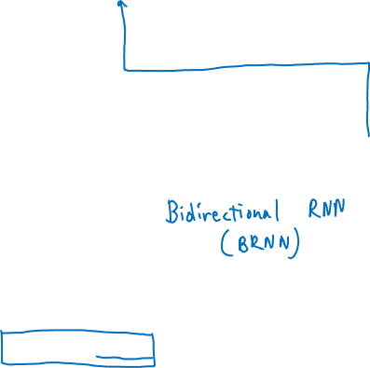



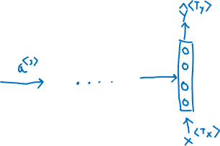


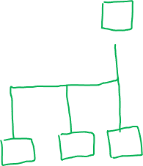
Recurrent Neural Networks
He said: "Teddy Roosevelt was a great president."
He said: "Teddy bears are on sale!"

Slide 7



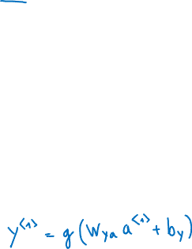




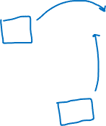






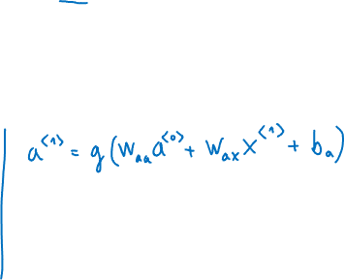




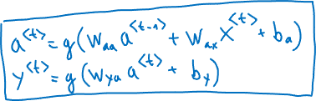
Forward Propagation
$${\hat{y}}^{<1>}$$
$${\hat{y}}^{<2>}$$
$${\hat{y}}^{<3>}$$
$${\hat{y}}^{<T_{y}>}$$
$$a^{<1>}$$
$$a^{<2>}$$
$$a^{<3>}$$
$$a^{<T_{x}−1>}$$
$$a^{<0>}$$
. . .
$$x^{<1>}$$
$$x^{<2>}$$
$$x^{<3>}$$
$$x^{<T_{x}>}$$

Slide 8


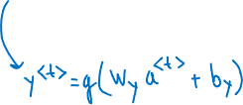


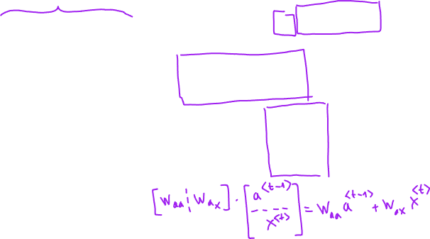
Simplified RNN notation
$$a^{<t>}=g\left(W_{aa}a^{<t−1>}+W_{ax}x^{<t>}+b_{a}\right)$$
$$y^{<t>}=g\left(W_{ya}a^{<t>}+b_{y}\right)$$

Slide 9



















Forward propagation and backward propagation
$${\hat{y}}^{<1>}$$
$${\hat{y}}^{<2>}$$
$${\hat{y}}^{<3>}$$
$${\hat{y}}^{<T_{y}>}$$
$$a^{<1>}$$
$$a^{<2>}$$
$$a^{<3>}$$
$$a^{<T_{x}−1>}$$
$$a^{<0>}$$
. . .
$$x^{<1>}$$
$$x^{<2>}$$
$$x^{<3>}$$
$$x^{<T_{x}>}$$

Slide 10



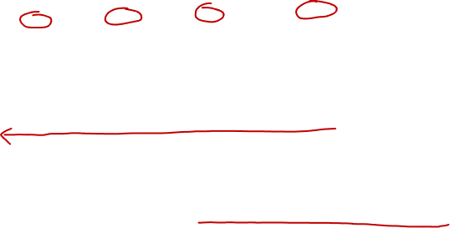



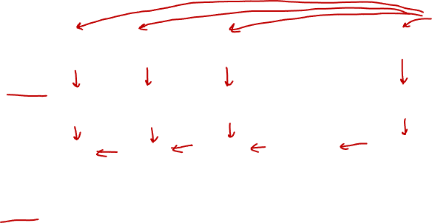


Forward propagation and backward propagation
$$ℒ^{<t>}\left({\hat{y}}^{<t>}\text{,}y^{<t>}\right)=$$
Backpropagation through time

Slide 11
Examples of RNN architectures

Slide 12
























Summary of RNN types
$${\hat{y}}^{<1>}$$
$${\hat{y}}^{<1>}$$
$${\hat{y}}^{<2>}$$
$${\hat{y}}^{<T_{y}>}$$
$$\hat{y}$$
…
$$a^{<0>}$$
…
$$a^{<0>}$$
$$a^{<0>}$$
$$x^{<1>}$$
$$x$$
$$x^{<1>}$$
$$x^{<2>}$$
$$x^{<T_{x}>}$$
One to one
One to many
Many to one
$${\hat{y}}^{<1>}$$
$${\hat{y}}^{<2>}$$
$${\hat{y}}^{<T_{y}>}$$
$${\hat{y}}^{<1>}$$
$${\hat{y}}^{<T_{y}>}$$
…
$$a^{<0>}$$
…
…
$$a^{<0>}$$
$$x^{<1>}$$
$$x^{<2>}$$
$$x^{<T_{x}>}$$
$$x^{<1>}$$
$$x^{<T_{x}>}$$
Many to many
Many to many

